Slide 1
Ethology
Cranberry Lake Biological Station
Wildlife Field Techniques

Slide 2
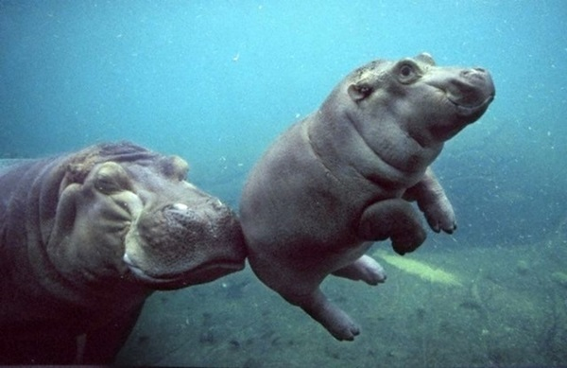
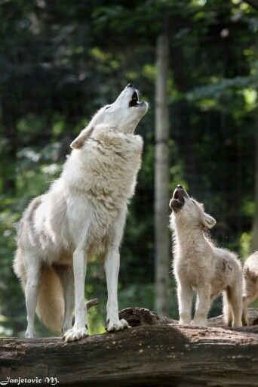
What is Ethology?
Ethology – the study of the proximate mechanisms and adaptive value of animal behavior
Why is it important to study animal behavior?

Slide 3
Ethology Topics
Ethology is a diverse field that includes many topics of study such as:
Activity Patterns – actions that occur over a defined period of time (what we’re doing today)
Kinematics – the physiological mechanics of motion
Acoustics – specifically examining communication or sensory reception of sound (often uses waveforms and sonograms)
Learning – examining an animal’s adaptations to environmental cues over a defined period of time

Slide 4
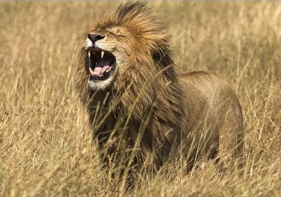
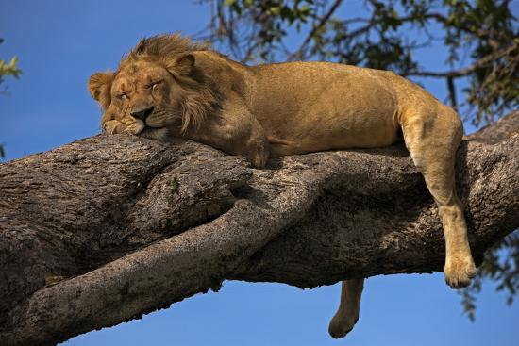
Types of Behaviors
State – a behavior with an extended duration (e.g. sleeping, moving)
Event – a behavior that can be quantified by number of occurrences (e.g. a single call, or single step)

Slide 5
Types of Sampling
Instantaneous – sampling at predetermined time intervals
Continuous – sampling throughout the entire time period
Focal – sampling one individual
Scan – sampling multiple individuals

Slide 6
What Are You Sampling?
Events
States
Events
Good for States
Continuous sampling of
Instantaneous sampling of
an Individual
a group
an individual
a group
Focal Sampling
Focal Sampling
Scan Sampling

Slide 7
Types of Sampling
Continuous Focal Sampling – constantly recording all behaviors of one individual
Instantaneous Focal Sampling – recording the state of a single individual at set intervals
Instantaneous Scan Sampling – recording the state of multiple individuals at set intervals

Slide 8
Types of Analyses
Sequence Analysis – sampling recorded behaviors to determine if a pattern exists
One-Zero Analysis – sampling for the presence of a specific behavior across each of the predetermined time periods

Slide 9
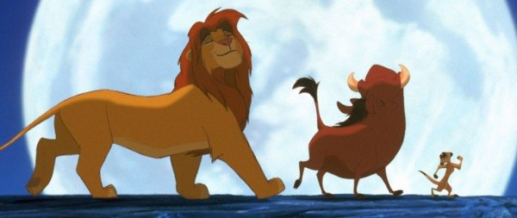
Caveats to Ethological Studies
You must predetermine the length of time over which you’re going to study the behavior
You must predetermine the categories of behaviors you’re going to use
You must avoid anthropomorphisms

Slide 10
Displaying Behavioral Data
Ethogram – a table of predetermined behaviors listed in alphabetical order with a detailed description of each behavior
Flow Diagram – a list of these behaviors in sequence as determined by your sequential analysis
Time Budget – a graph (usually a pie chart) depicting the breakdown of behaviors

Slide 11
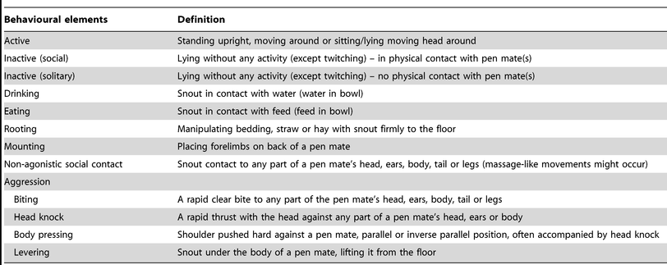
Ethogram

Slide 12
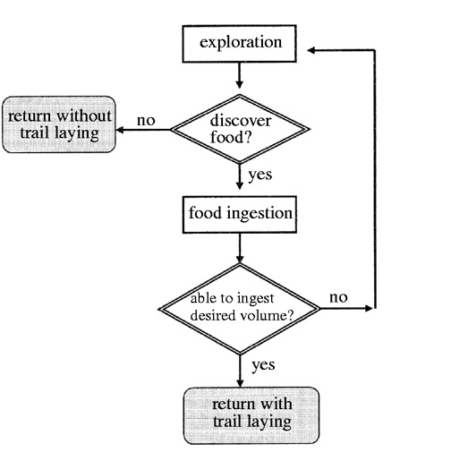
Flow Chart

Slide 13
Time Budget

Slide 14
Allotment Averages

Slide 15
American Robins at CLBS

